Slide 1


(hroshwo-i)

Slide 2
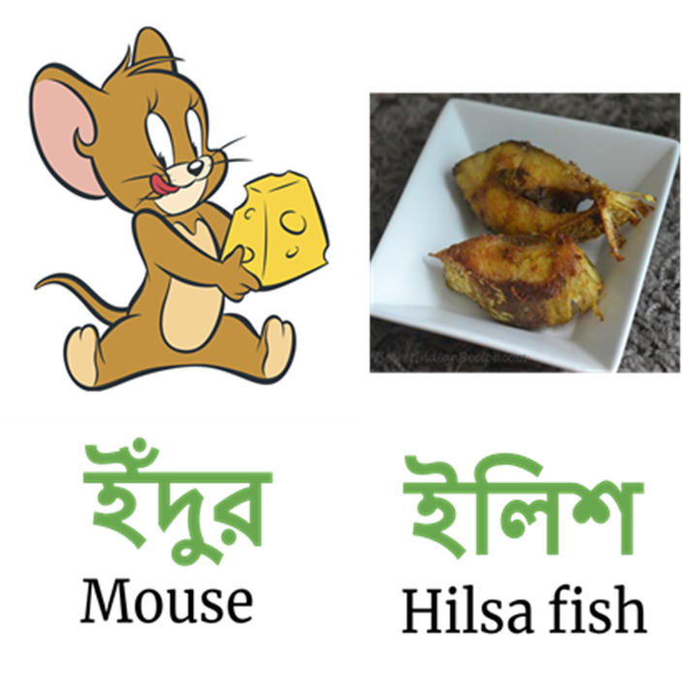
(indur)
(iliSh)

